Slide 1
Lexicographic ordering
The order that each string that appears in a dictionary. To determine which string is lexicographically larger we compare the corresponding characters of the two strings from left to right. The first character where the two strings differ determines which string comes first. Characters are compared using the Unicode character set and all uppercase letters come before lowercase letters.
Example:-
apple < orange because ‘a’ comes before ‘o’
Orange > orange because ‘O’ comes after ‘o’
apple = apple because all letters are the same

Slide 2
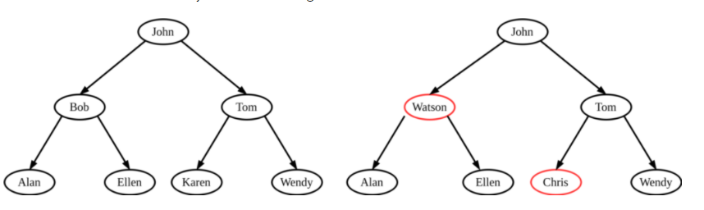
BST

Slide 3
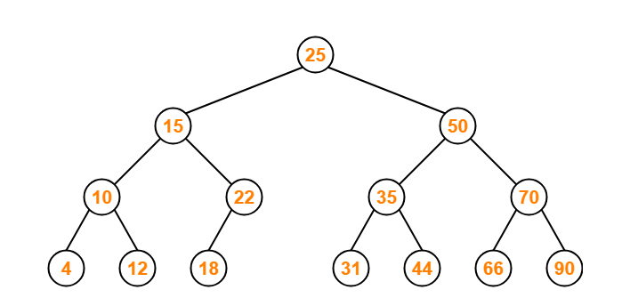

Slide 4
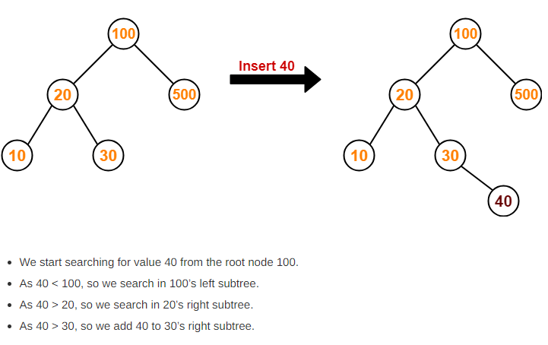
Insertion Operation in BST

Slide 5
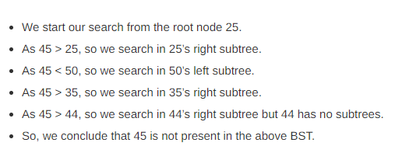
Search Operation

Slide 6
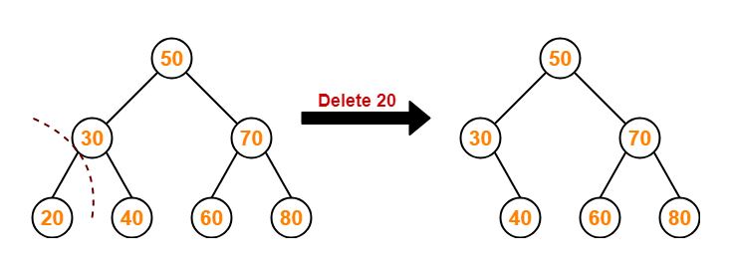
Deletion Operation in BST
1)Deletion Of A Node Having No Child (Leaf Node)

Slide 7
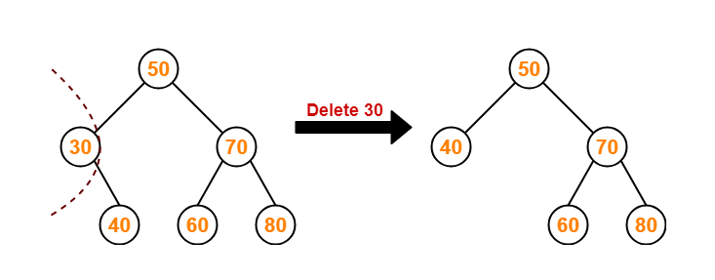
2)Deletion Of A Node Having Only One Child

Slide 8
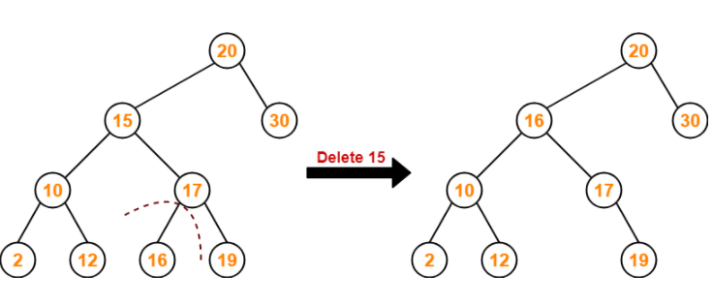
Deletion Of A Node Having Two Children
Method 1

Slide 9
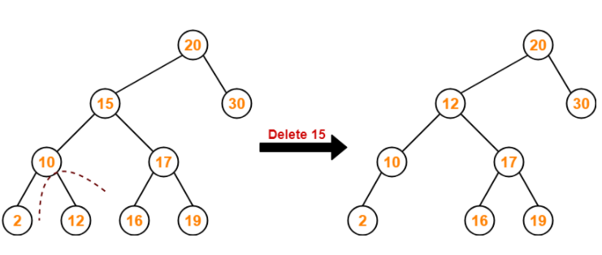
Method 2

